Slide 1

Big Omega

Slide 2
The team:
Yoana Stoyanova
SCRUM trainer
Magdalena Omayska
Front-end developer
Georgi Mihov
Back-end developer
Volen Mateev
Quality engineer

Slide 3
Stages of RealiZation

Slide 4

Planning

Slide 5

Realization

Slide 6

Presentation

Slide 7
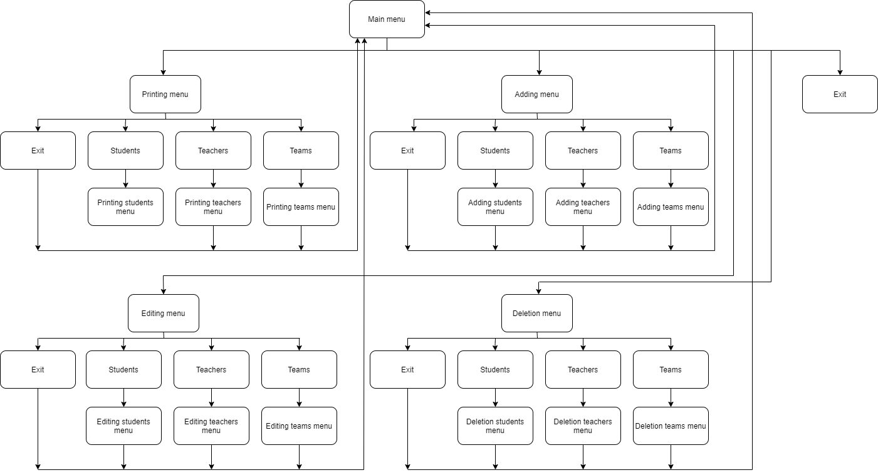
Diagram for our program

Slide 8
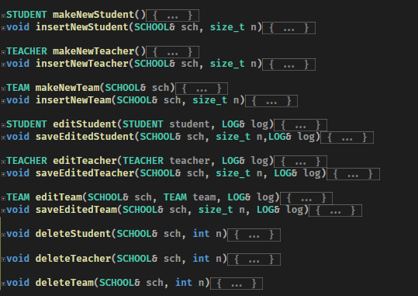
Some of the functions that we used

Slide 9






USED TECHNOLOGIES

Slide 10
Thank you for your attention!

Slide 11
Demonstration

